Slide 1
Stereochemistry of Alkanes and Cycloalkanes
CONFORMATIONS

Slide 2
The Shapes of Molecules
The three-dimensional shapes of molecules result from many forces
A molecule may assume different shapes, called conformations, that are in equilibrium at room temperature (the conformational isomers are called conformers, emphasis on the first syllable)
The systematic study of the shapes molecules and properties from these shapes is stereochemistry
The field of stereochemistry is one of the central parts of organic chemistry and includes many important topics

Slide 3

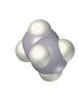


Conformations of Ethane
Conformers interconvert rapidly and a structure is an average of conformers
Molecular models are three dimensional objects that enable us to visualize conformers
Representing three dimensional conformers in two dimensions is done with standard types of drawings

Slide 4
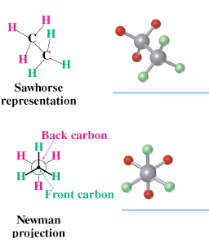
Representing Conformations
Sawhorse representations show molecules at an angle, showing a molecular model
  C-C bonds are at an angle to the edge of the page and all C-H bonds are shown
Newman projections show how the C-C bond would project end-on onto the paper
  Bonds to front carbon are lines going to the center
  Bonds to rear carbon are lines going to the edge of the circle

Slide 5
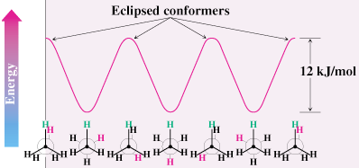
Ethane’s Conformations
There barrier to rotation between conformations is small (12 kJ/mol; 2.9 kcal/mol) The most stable conformation of ethane has all six C–H bonds away from each other (staggered)
The least stable conformation has all six C–H bonds as close as possible (eclipsed) in a Newman projection – energy due to torsional strain

Slide 6
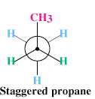
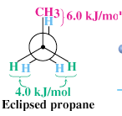
Conformations of Propane
Propane (C₃H₈) torsional barrier around the carbon–carbon bonds 14 kJ/mol
Eclipsed conformer of propane has two ethane-type H–H interactions and an interaction between C–H and C–C bond

Slide 7
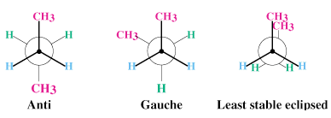
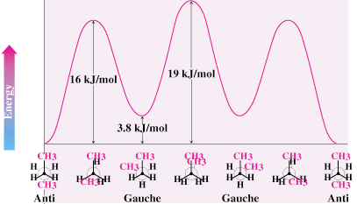
Conformations of Butane
anti conformation has two methyl groups 180° away from each other
Rotation around the C2–C3 gives eclipsed conformation
Staggered conformation with methyl groups 60° apart is gauche conformation

Slide 8
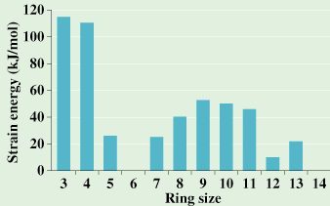
Stability of Cycloalkanes: The Baeyer Strain Theory
Baeyer (1885): since carbon prefers to have bond angles of approximately 109°, ring sizes other than five and six may be too strained to exist
Rings from 3 to 30 C’s do exist but are strained due to bond bending distortions and steric interactions

Slide 9
The Nature of Ring Strain
Rings larger than 3 atoms are not flat
Cyclic molecules can assume nonplanar conformations to minimize angle strain and torsional strain by ring-puckering
Larger rings have many more possible conformations than smaller rings and are more difficult to analyze

Slide 10
Summary: Types of Strain
Angle strain - expansion or compression of bond angles away from most stable
Torsional strain - eclipsing of bonds on neighboring atoms
Steric strain - repulsive interactions between nonbonded atoms in close proximity

Slide 11
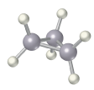
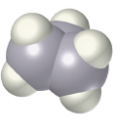
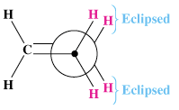
Cyclopropane: An Orbital View
3-membered ring must have planar structure
Symmetrical with C–C–C bond angles of 60°
Requires that sp³ based bonds are bent (and weakened)
All C-H bonds are eclipsed

Slide 12
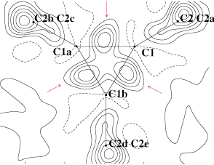
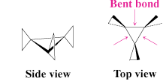
Bent Bonds of Cyclopropane
Structural analysis of cyclopropane shows that electron density of C-C bond is displaced outward from internuclear axis

Slide 13
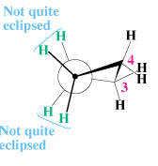


Conformations of Cyclobutane and Cyclopentane
Cyclobutane has less angle strain than cyclopropane but more torsional strain because of its larger number of ring hydrogens
Cyclobutane is slightly bent out of plane - one carbon atom is about 25° above
  The bend increases angle strain but decreases torsional strain

Slide 14
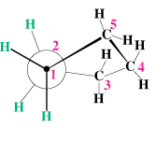


Cyclopentane
Planar cyclopentane would have no angle strain but very high torsional strain
Actual conformations of cyclopentane are nonplanar, reducing torsional strain
Four carbon atoms are in a plane
  The fifth carbon atom is above or below the plane – looks like an envelope

Slide 15

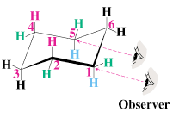
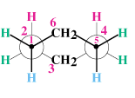

Conformations of Cyclohexane
Substituted cyclohexanes occur widely in nature
The cyclohexane ring is free of angle strain and torsional strain
The conformation is has alternating atoms in a common plane and tetrahedral angles between all carbons
This is called a chair conformation

Slide 16
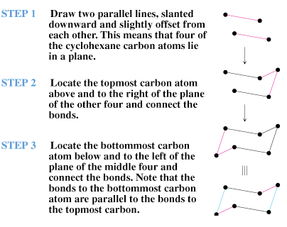
How to Draw Cyclohexane

Slide 17
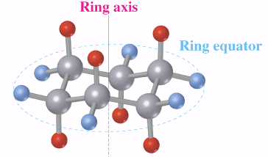
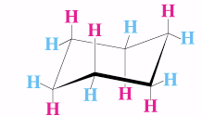
Axial and Equatorial Bonds in Cyclohexane
The chair conformation has two kinds of positions for substituents on the ring: axial positions and equatorial positions
Chair cyclohexane has six axial hydrogens perpendicular to the ring (parallel to the ring axis) and six equatorial hydrogens near the plane of the ring

Slide 18
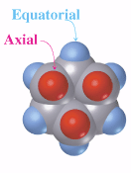
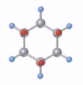
Axial and Equatorial Positions
Each carbon atom in cyclohexane has one axial and one equatorial hydrogen
Each face of the ring has three axial and three equatorial hydrogens in an alternating arrangement

Slide 19
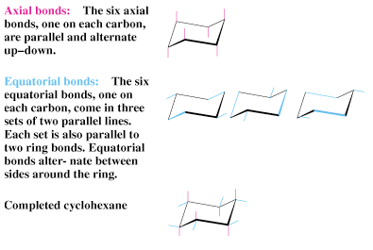
Drawing the Axial and Equatorial Hydrogens

Slide 20
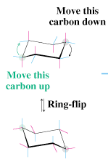



Conformational Mobility of Cyclohexane
Chair conformations readily interconvert, resulting in the exchange of axial and equatorial positions by a ring-flip

Slide 21
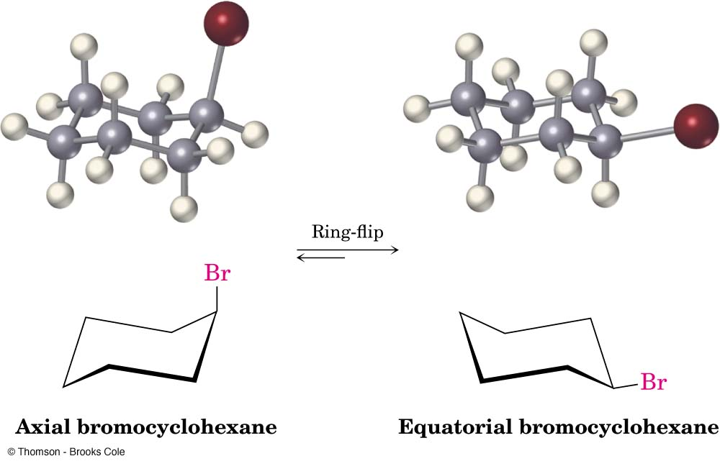
Bromocyclohexane
When bromocyclohexane ring-flips the bromine’s position goes from equatorial to axial and so on
At room temperature the ring-flip is very fast and the structure is seen as the weighted average

Slide 22
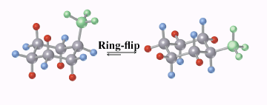
Conformations of Monosubstituted Cyclohexanes
The two conformers of a monosubstituted cyclohexane are not equal in energy
The equatorial conformer of methyl cyclohexane is more stable than the axial by 7.6 kJ/mol

Slide 23
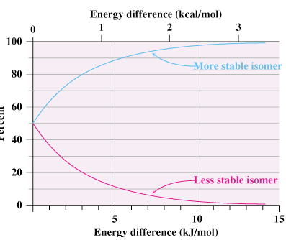
Energy and Equilibrium
The relative amounts of the two conformers depend on their difference in energy ΔE = −RT ln K
R is the gas constant [8.315 J/(K•mol)], T is the Kelvin temperature, and K is the equilibrium constant between isomers

Slide 24

1,3-Diaxial Interactions
Difference between axial and equatorial conformers is due to steric strain caused by 1,3-diaxial interactions
Hydrogen atoms of the axial methyl group on C1 are too close to the axial hydrogens three carbons away on C3 and C5, resulting in 7.6 kJ/mol of steric strain

Slide 25
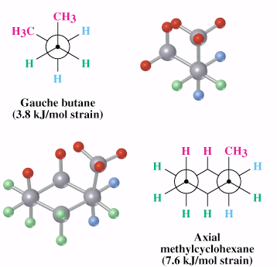
Relationship to Gauche Butane Interactions
Gauche butane is less stable than anti butane by 3.8 kJ/mol because of steric interference between hydrogen atoms on the two methyl groups
The four-carbon fragment of axial methylcyclohexane and gauche butane have the same steric interaction
In general, equatorial positions give more stable isomer

Slide 26
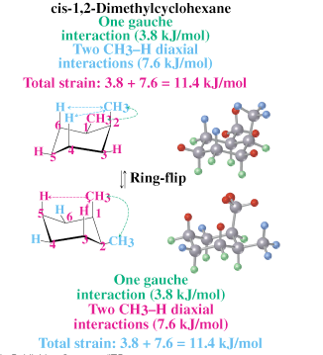
Conformational Analysis of Disubstituted Cyclohexanes
In disubstituted cyclohexanes the steric effects of both substituents must be taken into account in both conformations
There are two isomers of 1,2-dimethylcyclohexane. cis and trans
In the cis isomer, both methyl groups same face of the ring, and compound can exist in two chair conformations
Consider the sum of all interactions
In cis-1,2, both conformations are equal in energy

Slide 27
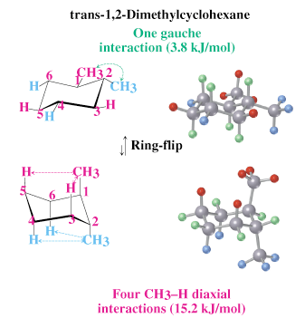
Trans-1,2-Dimethylcyclohexane
Methyl groups are on opposite faces of the ring
One trans conformation has both methyl groups equatorial and only a gauche butane interaction between methyls (3.8 kJ/mol) and no 1,3-diaxial interactions
The ring-flipped conformation has both methyl groups axial with four 1,3-diaxial interactions
Steric strain of 4 × 3.8 kJ/mol = 15.2 kJ/mol makes the diaxial conformation 11.4 kJ/mol less favorable than the diequatorial conformation
trans-1,2-dimethylcyclohexane will exist almost exclusively (>99%) in the diequatorial conformation

Slide 28
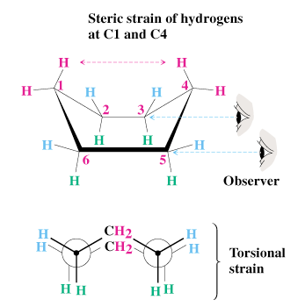
Boat Cyclohexane
Cyclohexane can also be in a boat conformation
Less stable than chair cyclohexane due to steric and torsional strain
C-2, 3, 5, 6 are in a plane
H on C-1 and C-4 approach each other closely enough to produce considerable steric strain
Four eclipsed H-pairs on C- 2, 3, 5, 6 produce torsional strain
~29 kJ/mol (7.0 kcal/mol) less stable than chair

Slide 29
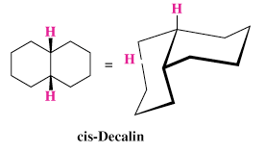
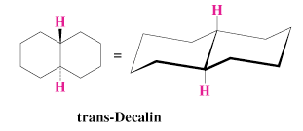
Conformations of Polycyclic Molecules
Decalin consists of two cyclohexane rings joined to share two carbon atoms (the bridgehead carbons, C1 and C6) and a common bond
Two isomeric forms of decalin: trans fused or cis fused
In cis-decalin hydrogen atoms at the bridgehead carbons are on the same face of the rings
In trans-decalin, the bridgehead hydrogens are on opposite faces
Both compounds can be represented using chair cyclohexane conformations
Flips and rotations do not interconvert cis and trans

Slide 30
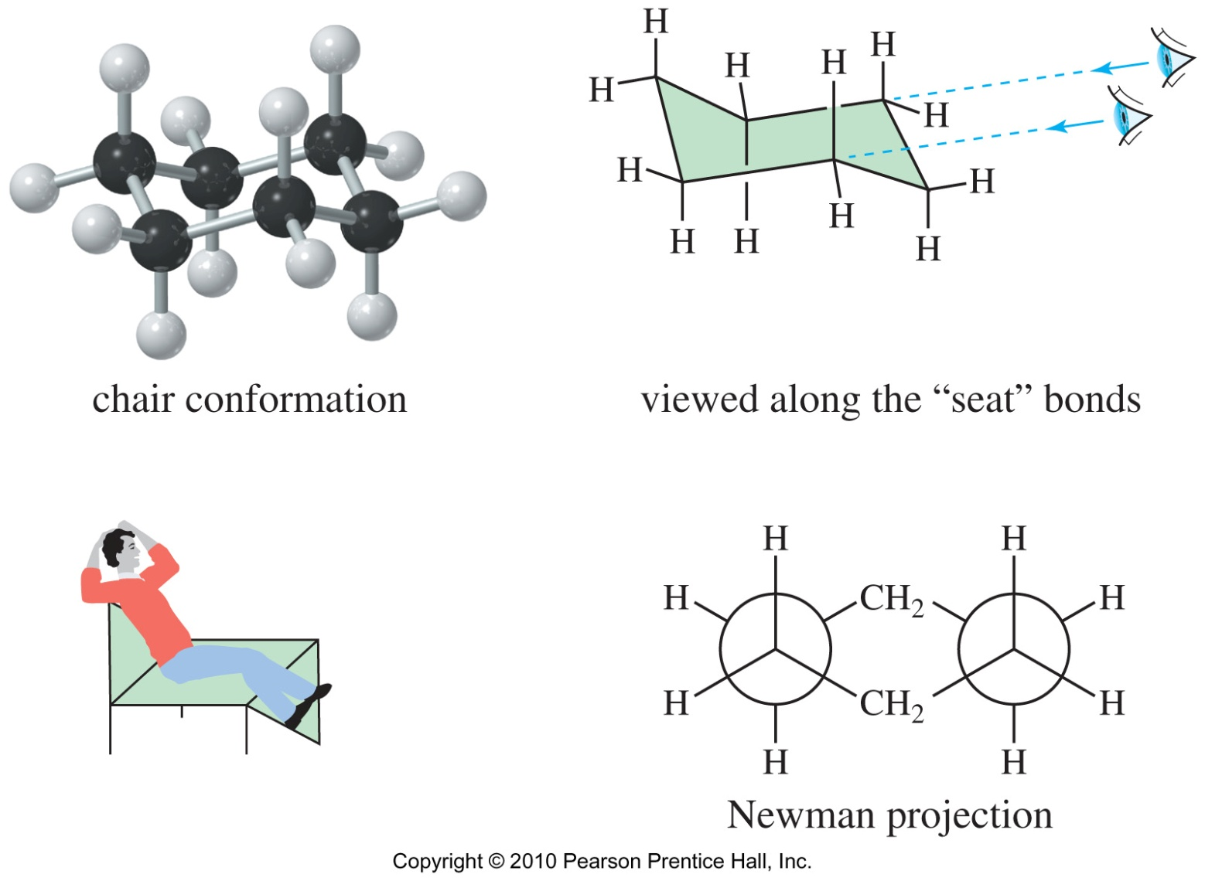
Chair Conformation of Cyclohexane
Chapter 3
Notes:
Figure: 03_19.jpg
Title:
Conformations of Cyclohexane
Caption:
The chair conformation of cyclohexane has one methylene group puckered upward and another puckered downward. Viewed from the Newman projection, the chair conformation has no eclipsing of the carbon-carbon bonds. The bond angles are 109.5°.
Notes:
Cyclohexane can adopt four non-planar conformations: chair, boat, twist boat, and half-chair. The most stable conformation is the chair because it has all the C-H bonds staggered.

Slide 31
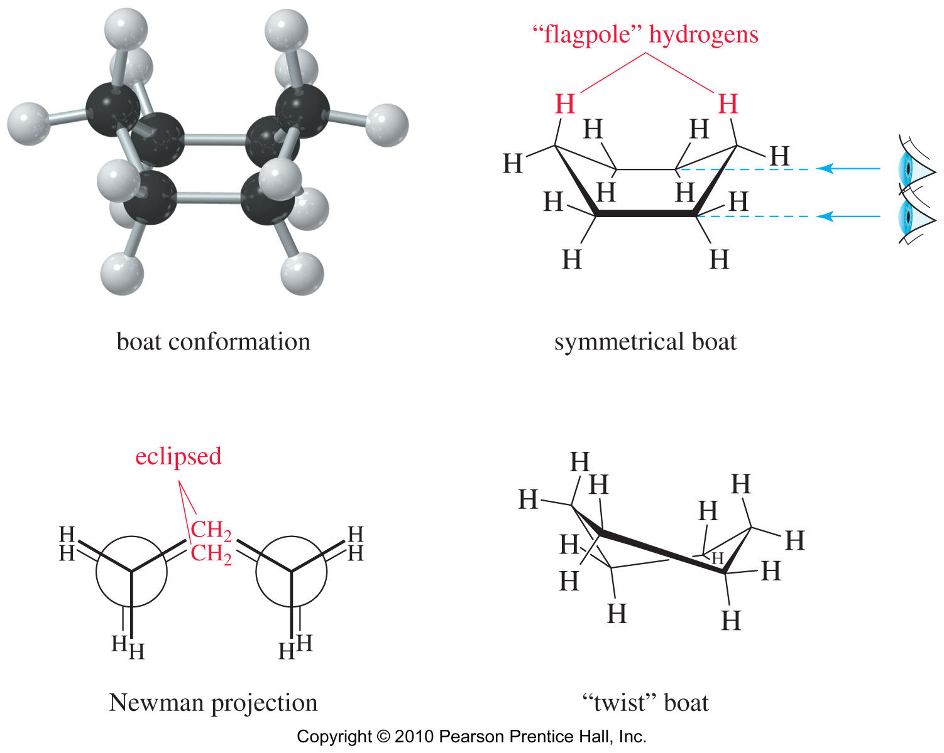
Boat Conformation of Cyclohexane
Chapter 3
Notes:
Figure: 03_20.jpg
Title:
Boat Conformation of Cyclohexane
Caption:
In the symmetrical boat conformation of cyclohexane, eclipsing of bonds results in torsional strain. In the actual molecule, the boat conformation is skewed to give the twist boat, a conformation with less eclipsing of bonds and less interference between the two flagpole hydrogens.
Notes:
In the boat conformation all bonds are staggered except for the “flagpole” hydrogens. There is steric hindrance between these hydrogens so the molecule twists a little producing the twist boat conformation which is 1.4 kcal (6 kJ) lower in energy than the boat.

Slide 32
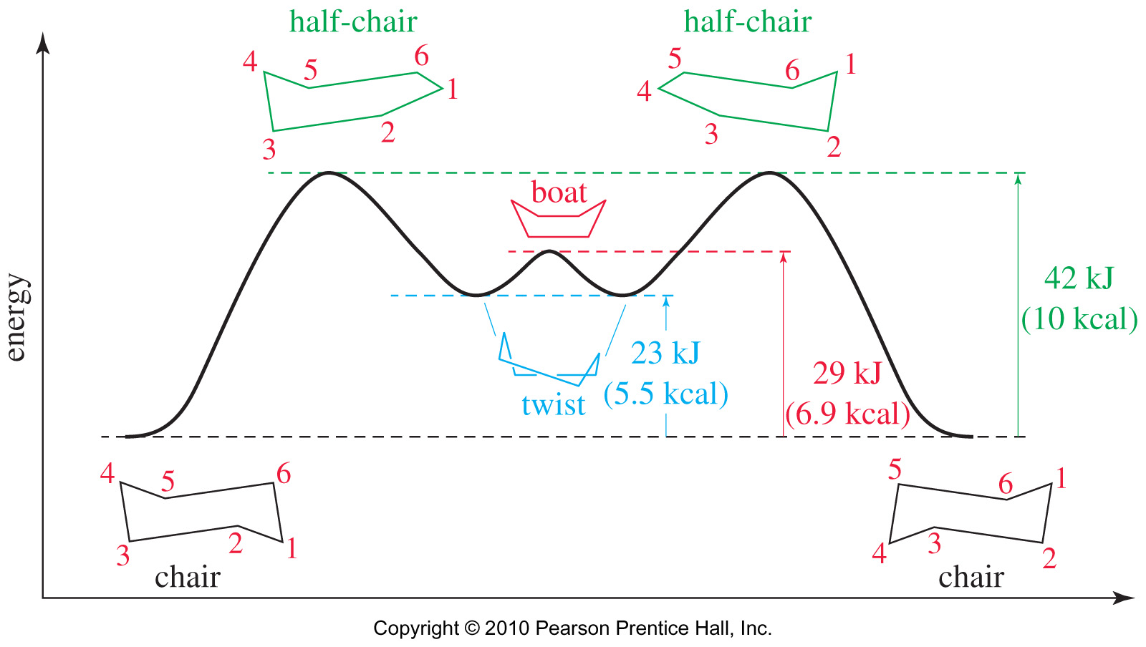
Conformational Energy Diagram of Cyclohexane
Chapter 3
Notes:
Figure: 03_21.jpg
Title:
Conformational Energy Diagram of Cyclohexane
Caption:
Conformational energy of cyclohexane. The chair conformation is most stable, followed by the twist boat. To convert between these two conformations, the molecule must pass through the unstable half-chair conformation.
Notes:
Interconversion between chair conformations require that cyclohexane go through its higher energy conformations.

Slide 33
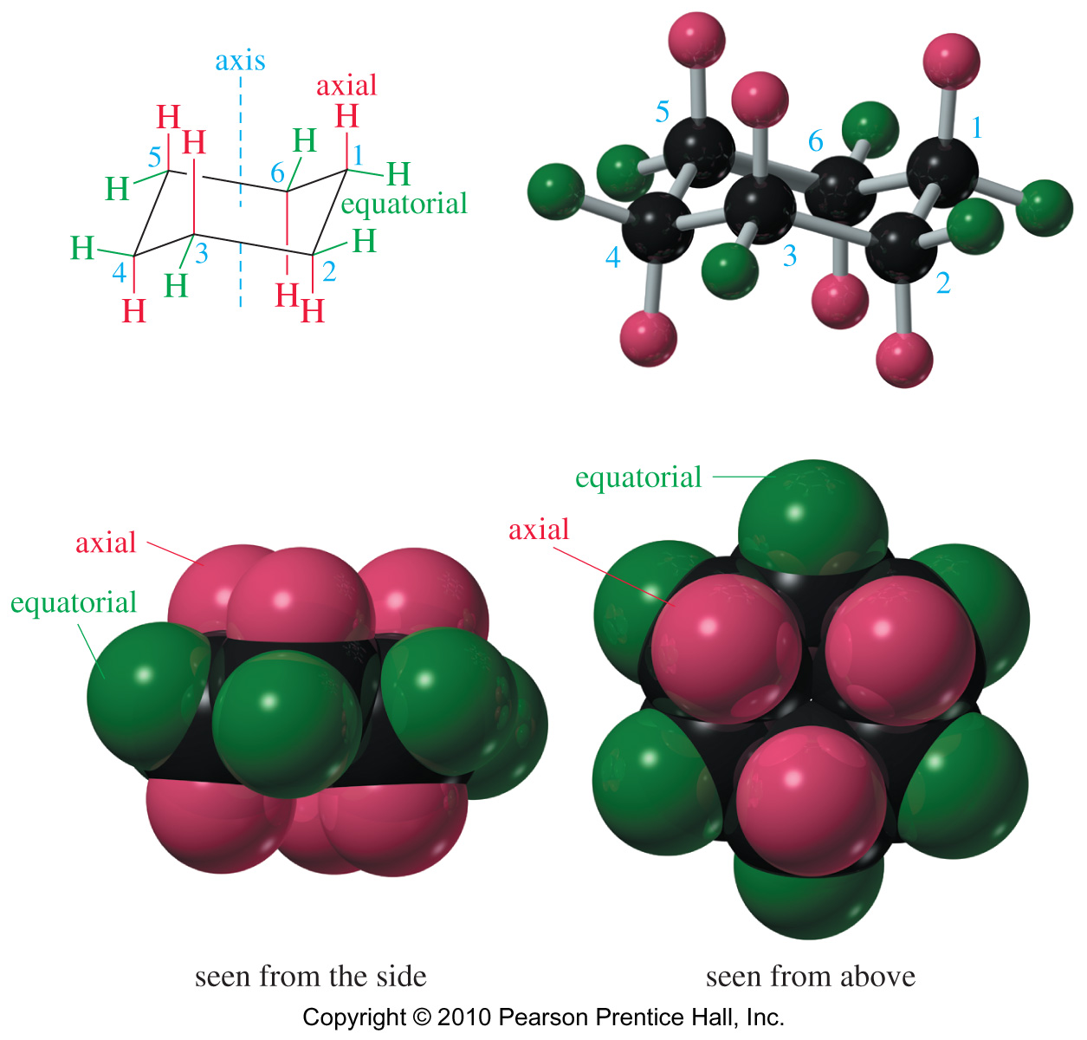
Axial and Equatorial Positions
Chapter 3
Notes:
Figure: 03_22.jpg
Title:
Chair Conformation of Cyclohexane
Caption:
The axial bonds are directed vertically, parallel to the axis of the ring. The equatorial bonds are directed outward, toward the equator of the ring. As they are numbered here, the odd-numbered carbons have their upward bonds axial and their downward bonds equatorial. The even-numbered carbons have their downward bonds axial and their upward bonds equatorial.
Notes:
All the C-H bonds are staggered in the chair conformation. Axial hydrogens are pointed straight up or down, parallel to the axis of the ring. Equatorial hydrogens, like their name suggests, are pointed out of the ring along the “equator” of the molecule.

Slide 34
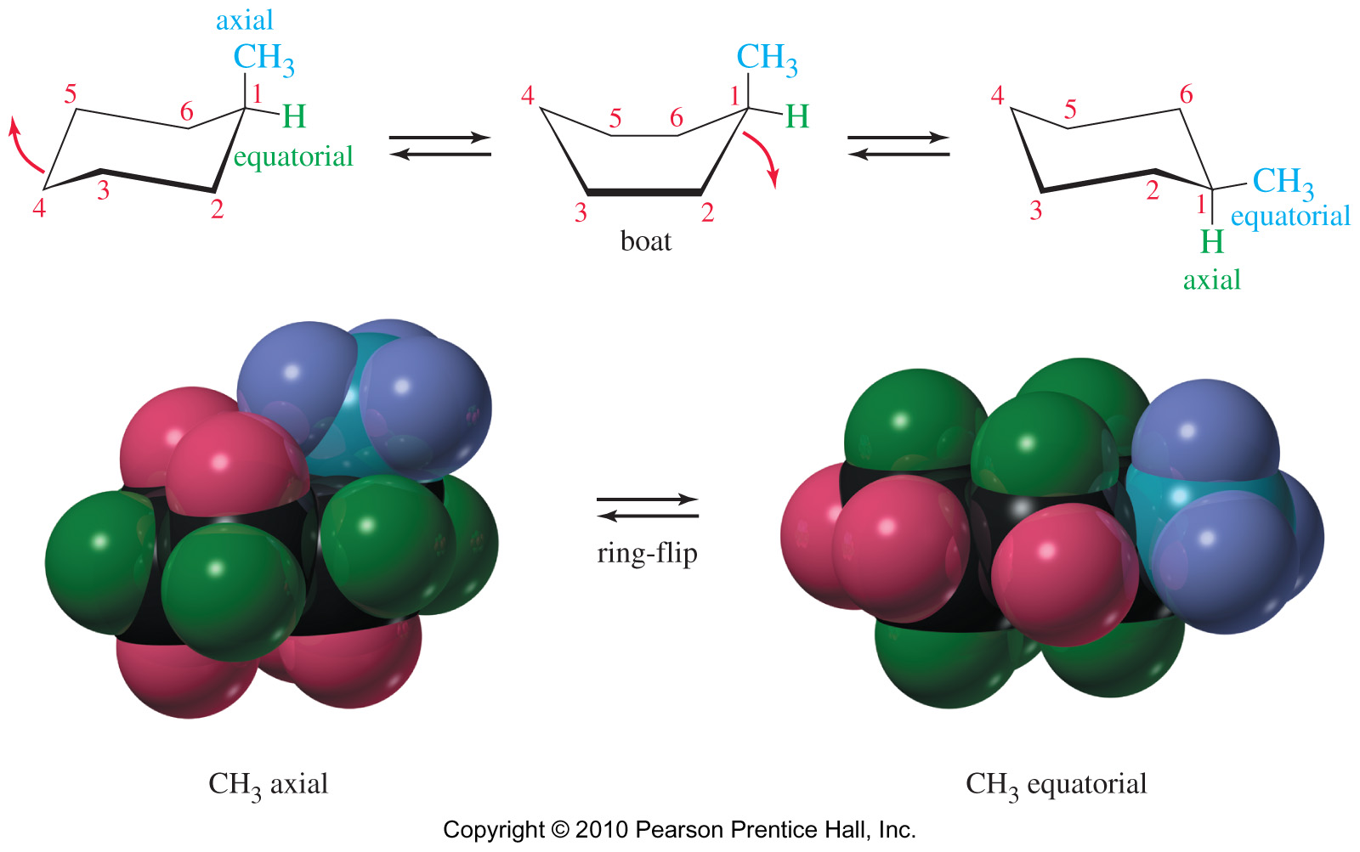
Chair–Chair Interconversion
The most important result in chair conversion is that any substituent
that is axial in the original conformation becomes equatorial in the
new conformation.
Chapter 3
Notes:
Figure: 03_23.jpg
Title:
Chair-Chair Interconversion
Caption:
Chair-chair interconversion of methylcyclohexane. The methyl group is axial in one conformation, and equatorial in the other.
Notes:

Slide 35
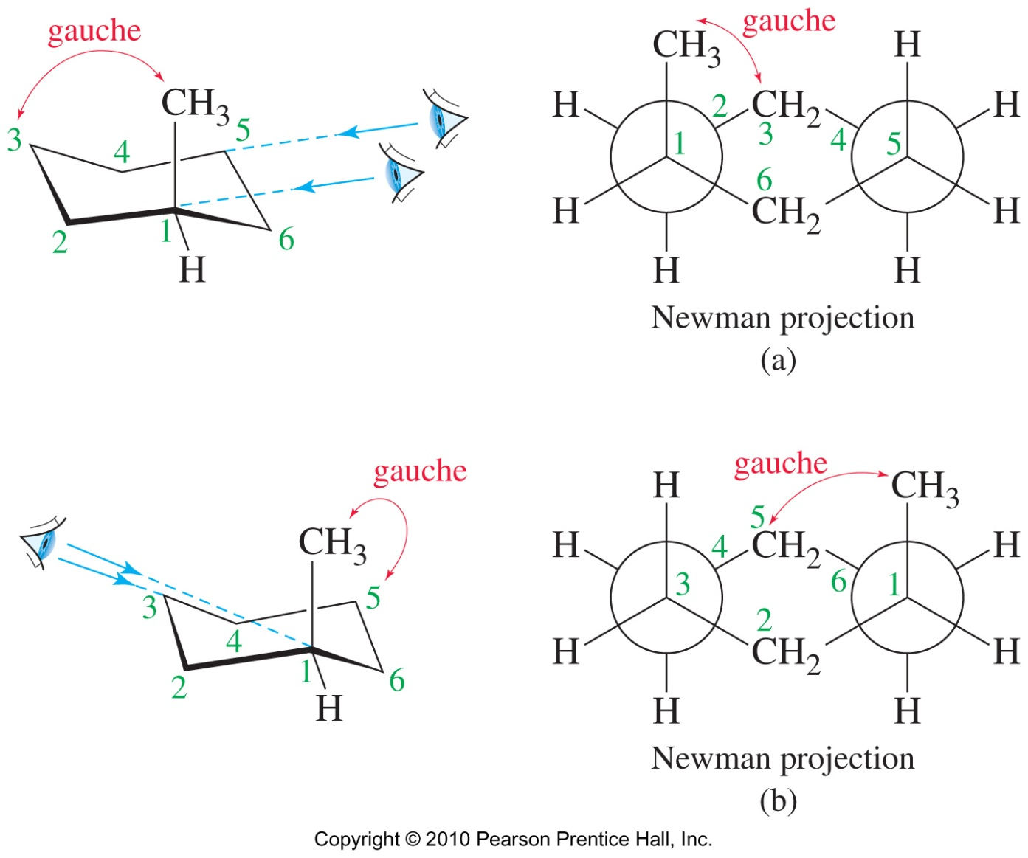
Axial Methyl in Methylcyclohexane
Chapter 3
Notes:
Figure: 03_24.jpg
Title:
Newman Projection of Methylcyclohexane: Methyl Axial
Caption:
(a) When the methyl substituent is in an axial position on C1, it is gauche to C3. (b) The axial methyl group on C1 is also gauche to C5 of the ring.
Notes:
In the Newman projection it is easier to see the steric interaction between the methyl substituent and the hydrogens and carbons of the ring.

Slide 36
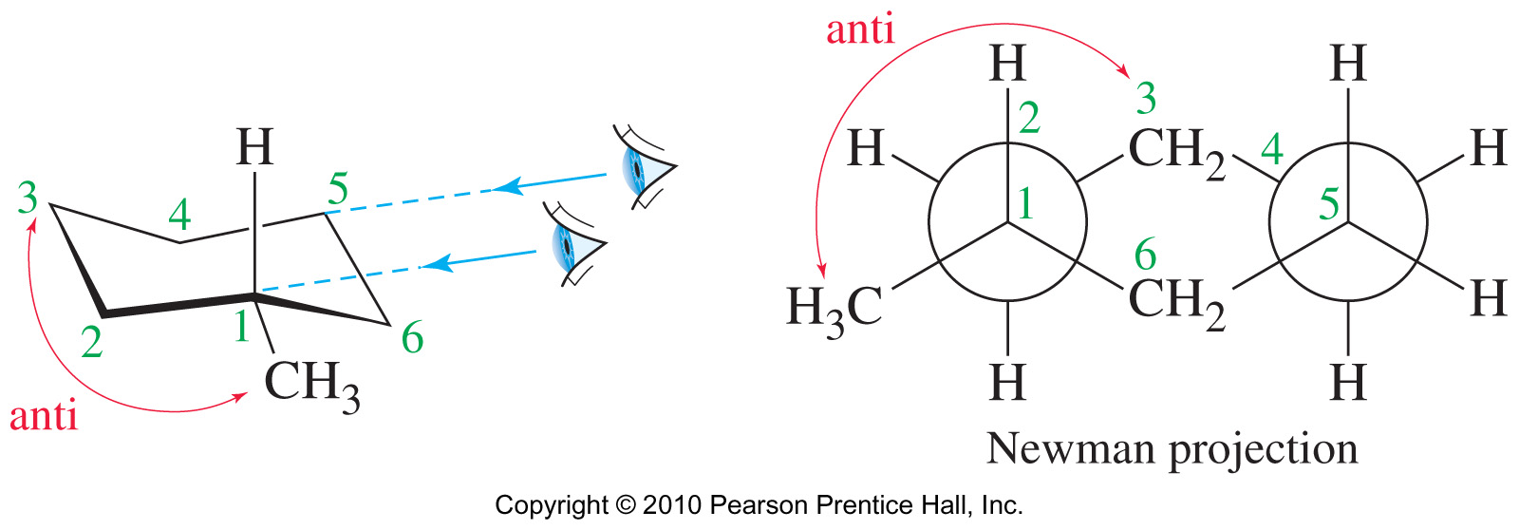
Equatorial Methyl Group
Chapter 3
Notes:
Figure: 03_25.jpg
Title:
Newman Projection of Methylcyclohexane: Methyl Equatorial
Caption:
Looking down the C1-C2 bond of the equatorial conformation, we find that the methyl group is anti to C3.
Notes:
An equatorial methyl group will be anti to the C3. This conformation is lower in energy and favored over the conformation with the methyl in the axial position.

Slide 37
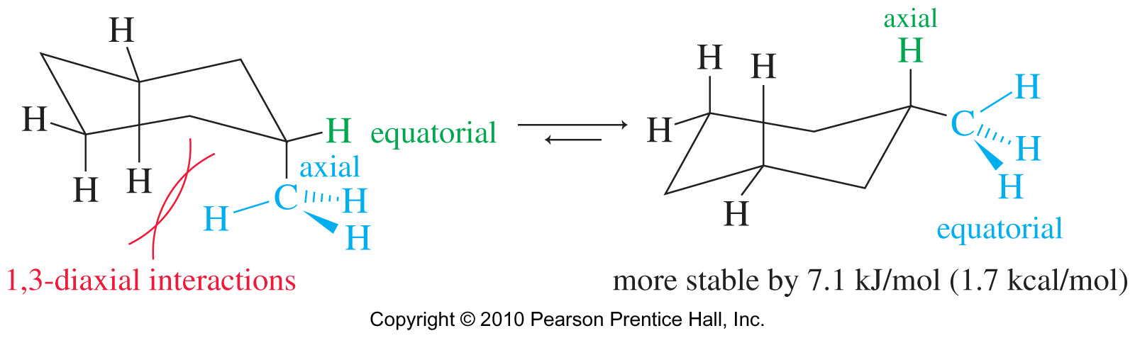
1,3-Diaxial Interaction
The axial substituent interferes with the axial hydrogens on C3 and C5. This interference is called a 1,3-diaxial interaction.
Chapter 3
Notes:
Figure: 03_26.jpg
Title:
1,3-Diaxial Interaction
Caption:
The axial substituent interferes with the axial hydrogens on C3 and C5. This interference is called a 1,3-diaxial interaction.
Notes:

Slide 38
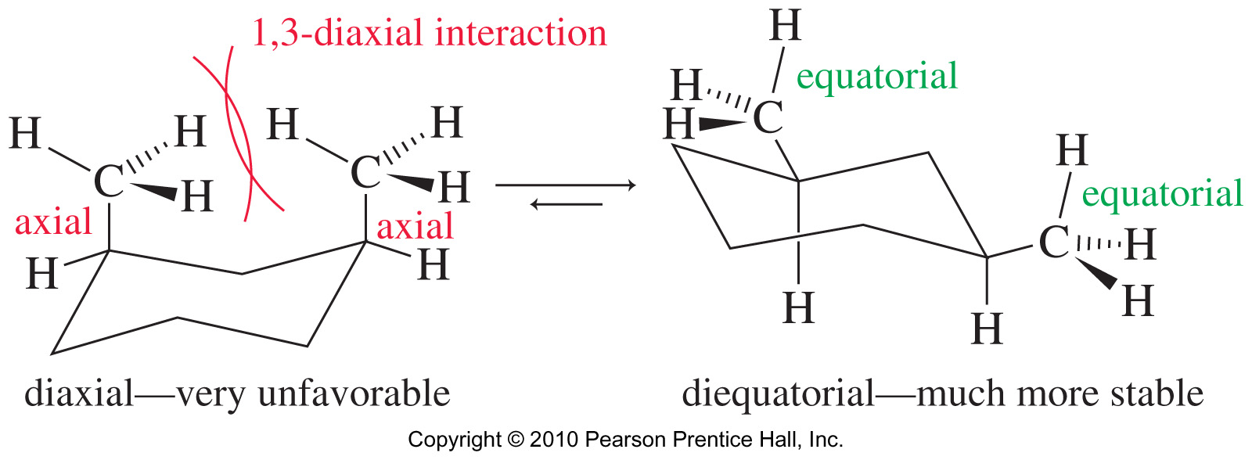
Cis-1,3-dimethylcyclohexane
Cis-1,3-dimethylcyclohexane can have both methyl groups in axial positions or both in equatorial positions.
The conformation with both methyl groups being equatorial is more stable.
Chapter 3
Notes:
Figure: 03_26-01UN.jpg
Title:
Chair Conformations of cis-1,3-Dimethylcyclohexane
Caption:
Two chair conformations are possible for cis-1,3-dimethylcyclohexane. The unfavorable conformation has both methyl groups in axial positions, with a 1,3-diaxial interaction between them. The more stable conformation has both methyl groups in equatorial positions.
Notes:
Alkyl substituents on cyclohexane rings will tend to be equatorial to avoid 1,3-diaxial interactions. cis-1,3-dimethylcyclohexane can have both methyl groups on axial positions but the conformation with both methyls in equatorial positions is favored.

Slide 39
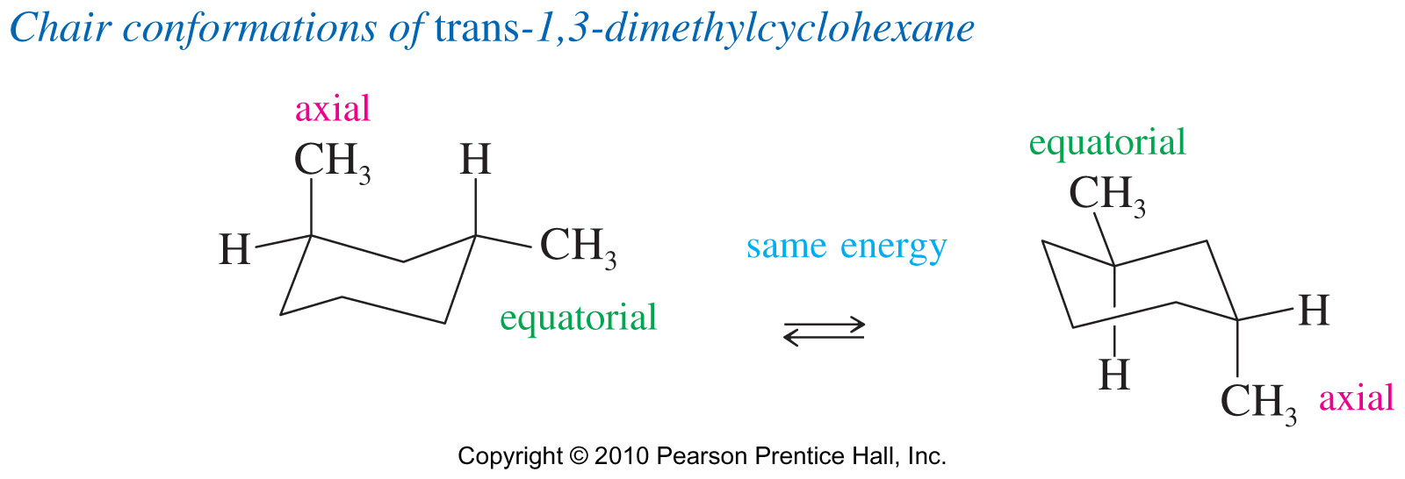
Trans-1,3-dimethylcyclohexane
Both conformations have one axial and one equatorial methyl group so they have the same energy.
Chapter 3
Notes:
Figure: 03_26-02UN.jpg
Title:
Chair Conformations of trans-1,3-Dimethylcyclohexane
Caption:
Either of the chair conformations of trans-1,3-dimethylcyclohexane has one methyl group in an axial position and one in an equatorial position. These conformations have equal energies, and they are present in equal amounts.
Notes:
Alkyl substituents on cyclohexane rings will tend to be equatorial to avoid 1,3-diaxial interactions. trans-1,3-dimethylcyclohexane has one methyl group axial and the other equatorial. Chair interconversion would still produce an axial and an equatorial methyl. In this case both chairs have the same energy, and they are present in equal amounts.

Slide 40
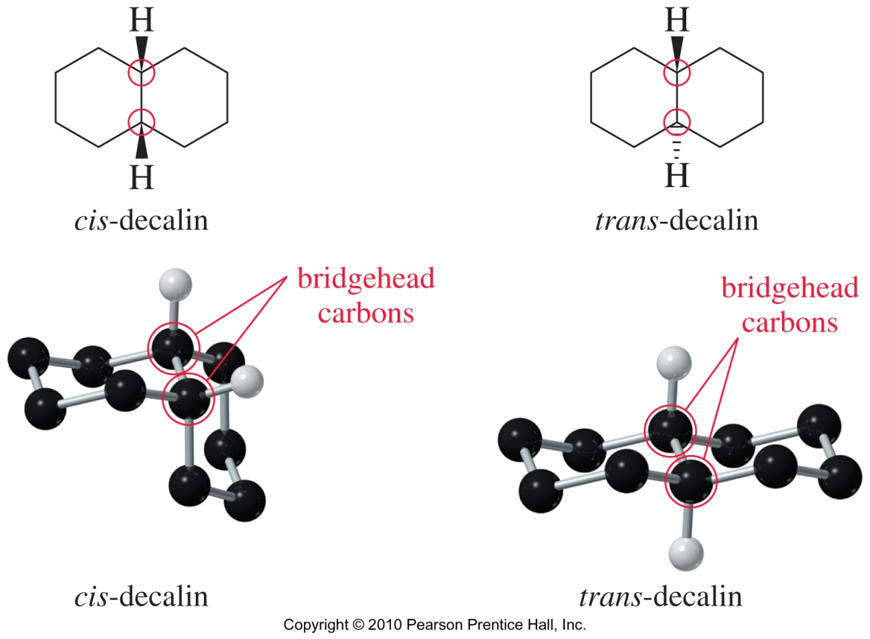
Decalin
Cis-decalin has a ring fusion where the second ring is attached by two cis bonds. Trans-decalin is fused using two trans bonds. Trans-decalin is more stable because the alkyl groups are equatorial.
Chapter 3
Notes:
Figure: 03_27.jpg
Title:
cis- and trans-Decalin
Caption:
cis-Decalin has a ring fusion where the second ring is attached by two cis bonds. trans-Decalin is fused using two trans bonds. The six-membered rings in cis- and trans-decalin assume chair conformations.
Notes:
The correct IUPAC name for decalin is bicyclo[3.3.0]decane but it is commonly known as decalin. There are two possible geometric isomers for decalin: cis and trans.

Slide 41
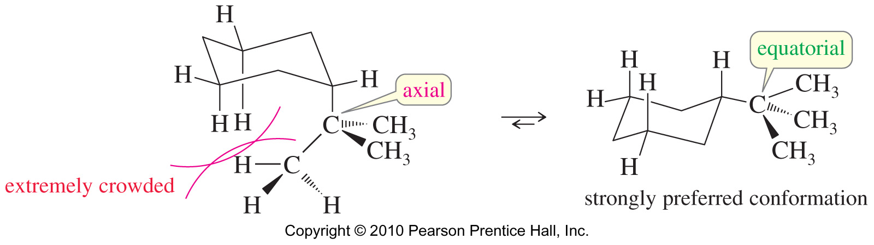
Tert-butylcyclohexane
Substituents are less crowded in the equatorial positions.
Chapter 3
Notes:
Figure: 03_27-11UN.jpg
Title:
Conformations with Extremely Bulky Groups
Caption:
Some groups are so bulky that they are extremely hindered in axial positions. Cyclohexanes with tertiary-butyl substituents show that an axial t-butyl group is severely hindered. Regardless of the other groups present, the most stable conformation has a t-butyl group in an equatorial position. The following figure shows the severe steric interactions in a chair conformation with a t-butyl group axial.
Notes:
Alkyl substituents on cyclohexane rings will tend to be equatorial to avoid 1,3-diaxial interactions. Groups like tert-butyl are so bulky that it will force the chair conformation where it is in the equatorial position, regardless of other groups present.

Slide 42
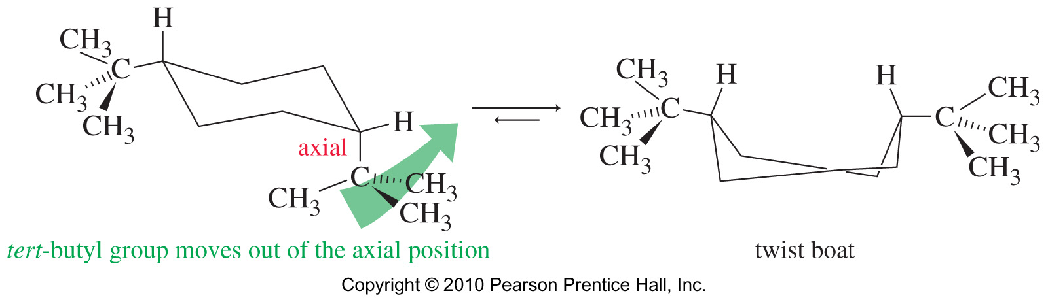
Cis-1,4-ditertbutylcyclohexane
The most stable conformation of cis-1,4-di-tertbutylcyclohexane is the twist boat. Both chair conformations require one of the bulky t-butyl groups to occupy an axial position.
Chapter 3
Notes:
Figure: 03_27-12UN.jpg
Title:
Conformation of 1,4-di-t-butylcyclohexane
Caption:
The most stable conformation of cis-1,4-di-t-butylcyclohexane is a twist boat. Either of the chair conformations requires one of the bulky t-butyl groups to occupy an axial position.
Notes:
Since tert-butyl groups are most stable in the equatorial positions, when two t-butyl groups are present they will force the cyclohexane to interconvert to the twist boat conformation.

Slide 43
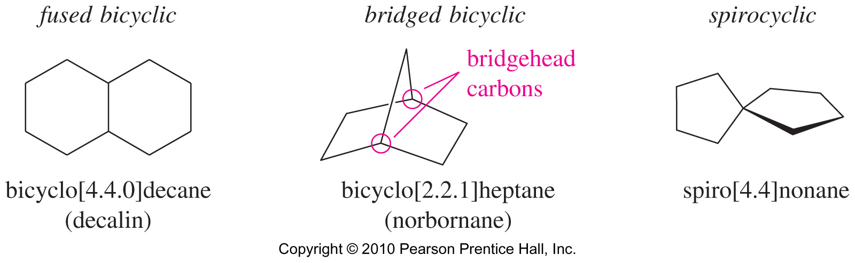
Bicyclic Systems
Chapter 3
Notes:
Figure: 03_28-01UN.jpg
Title:
Bicyclic Compounds
Caption:
Two or more rings can be joined into bicyclic or polycyclic systems. There are three ways that two rings may be joined. Fused rings are most common, sharing two adjacent carbon atoms and the bond between them. Bridged rings are also common, sharing two nonadjacent carbon atoms (the bridgehead carbons) and one or more carbon atoms (the bridge) between them. Spirocyclic compounds, in which the two rings share only one carbon atom, are relatively rare.
Notes:
Three examples of bicyclic ring systems can be fused, bridged, or spirocyclic. Fused and bridged bicyclic rings are joined together by two carbons; in fused bicycles the two carbons are adjacent while in bridged bicycles the carbons are nonadjacent. Spirocycles are joined by only one carbon.

Slide 44
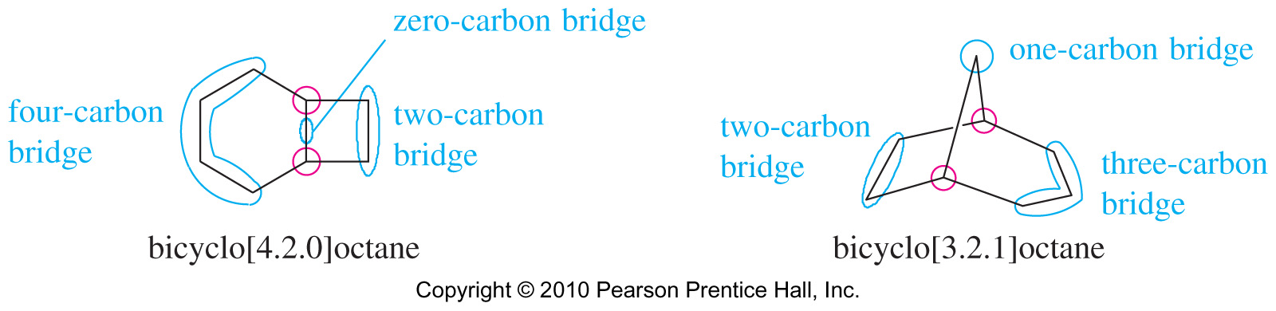
Nomenclature of Bicyclic Systems
Bicyclo [#.#.#]alkane
Where # are the number of carbons on the bridges (in decreasing order) and the alkane name includes all the carbons in the compound.
Chapter 3
Notes:
Figure: 03_28-02UN.jpg
Title:
Nomenclature of Bicyclic Compounds
Caption:
The name of a bicyclic compound is based on the name of the alkane having the same number of carbons as there are in the ring system. This name follows the prefix bicyclo and a set of brackets enclosing three numbers. The following examples contain eight carbon atoms and are named bicyclo[4.2.0]octane and bicyclo[3.2.1]octane, respectively.
Notes:
When naming bicyclic rings, the alkane name used will denote the total amount of carbons in the compound. The prefix bicyclo is used followed by three numbers in brackets. These three numbers represent the number of carbons that bridge (connect) the two shared carbons. In the case of spirocycles, the prefix spiro is used instead of bicycle and only two numbers are written.

Slide 45
Solved Problem 3-3
(a) Draw both chair conformations of cis-1,2-
dimethylcyclohexane, and determine which
conformer is more stable.
(b) Repeat for the trans isomer.
(c) Predict which isomer (cis or trans) is more stable.
Chapter 3
Notes:
Copyright © 2006 Pearson Prentice Hall, Inc.

Slide 46
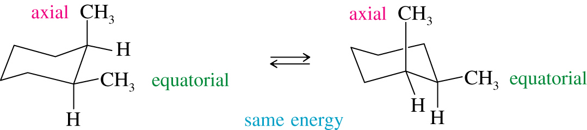
Solved Problem 3-3: Solution (a)
There are two possible chair conformations for the cis isomer, and these two conformations interconvert at room temperature. Each of these conformations places one methyl group axial and one equatorial, giving them the same energy.
Chapter 3
Notes:
Copyright © 2006 Pearson Prentice Hall, Inc.

Slide 47
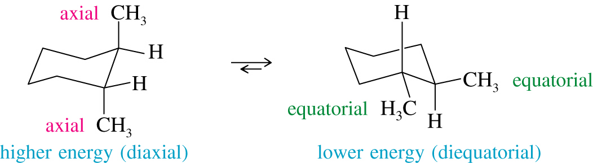
Solved Problem 3-3 : Solution (b)
(b) There are two chair conformations of the trans isomer that interconvert at room temperature. Both methyl groups are axial in one, and both are equatorial in the other. The diequatorial conformation is more stable because neither methyl group occupies the more hindered axial position.
Chapter 3
Notes:
Copyright © 2006 Pearson Prentice Hall, Inc.

Slide 48
Solved Problem 3-3 : Solution (c)
(c) The trans isomer is more stable. The most stable conformation of the trans isomer is diequatorial and therefore about 7.6 kJ/mol (1.8 kcal/mol) lower in energy than either conformation of the cis isomer, each having one methyl axial and one equatorial. Remember that cis and trans are distinct isomers and cannot interconvert.
Chapter 3
Notes:
Copyright © 2006 Pearson Prentice Hall, Inc.

Slide 49

Solved Problem 3-1
Draw the most stable conformation of trans-1-ethyl-3-methylcyclohexane.
Solution: First, we draw the two conformations. The ethyl group is bulkier than the methyl group, so the conformation with the ethyl group equatorial is more stable.
Chapter 3
Notes:
Copyright © 2006 Pearson Prentice Hall, Inc.

